Slide 1
Synchronization of estrus

Slide 2
Synchronization of estrus
implies the manipulation of the estrus cycle or induction of estrus to bring a large percentage of females into estrus at a predetermined time
Advantages
1- with embryo transfer programs
2- easily inseminate the animals at the same time
3- easily detect the estrus and overcoming the problems of estrus detection
4- parturitions in all animals will occur at the same time

Slide 3
Synchronization of estrus programs
Progesterone
Prostaglandin F2 alpha

Slide 4
1- Progesterone
The progesterone suppress the pituitary hormones all over the period of treatment
rebound effect of cutting progesterone lead to releasing the pituitary and hypothalamus hormones
Releasing pituitary hormones especially FSH lead to exhibiting estrus

Slide 5
Progesterone administration methods
Oral (feeding) progesterone
PRIDS (progesterone releasing intra-vaginal devices)
CIDRS (controlled internal drugs releasing)
Vaginal progesterone pessaries
Vaginal progesterone sponges
Norgestomet (synthetic progestin) ear implant

Slide 6
Progesterone administration methods
Oral (feeding) progesterone
MGA (melengestrol acetate) 10 mg daily for 18 day
After finishing the feeding the estrus cycle will appear after 3-4 days in these animals

Slide 7
Progesterone administration methods
2- PRIDS (progesterone releasing intra-vaginal devices)
Spiral piece covered with silicon containing 1.55 g progesterone + 10 mg estradiol benzoate
Estradiol benzoate for induction luteolysis for corpus luteum if present
PRID introduce inside vagina for 12 day which absorbs the progesterone through mucus membrane
After withdrawal PRID the estrus will appear after 3-4 days from withdrawal

Slide 8
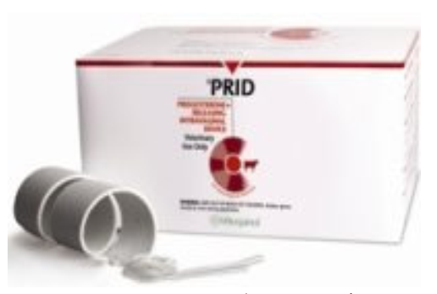

Slide 9
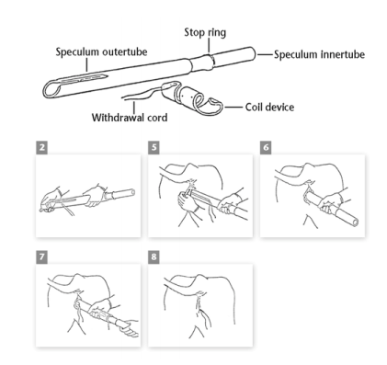

Slide 10
Progesterone administration methods
3- CIDRS (controlled internal drugs releasing)
Plastic piece like Y letter with a thread for the purpose of pulling it
Containing 1.38 g progesterone
CIDRS introduce inside vagina for 12 day by a special probe
After withdrawal CIDRS the estrus will appear after 2-3 days from withdrawal
( this technique like progesterone pessireies and sponges)

Slide 11
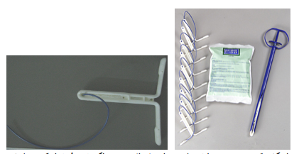

Slide 12
Progesterone administration methods
4- Progesterone ear implants
Small Plastic piece contain synthetic progesterone (3 mg Norgestomet)
Introduce as an ear implant by special syringe or introducer
At the same time inject with 3 mg Norgestomet and 5 mg estradiol
The ear implant remove after 9-10 days
The estrus will appear after 2-3 days

Slide 13
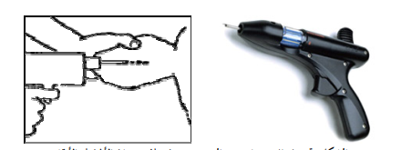

Slide 14
2- prostaglandin f2 alpha
PGF2α is use for estrus synchronization according to its effect on mature corpus luteum (CL) (maturity of CL occur after 5-6 days from its formation)
The programs of PGF2α are:
1- Firstly the animals examine rectally to determine the presence of mature CL, then these animals injected with PGF2α, then the estrus will appear after 2-3 days for these animals

Slide 15
2- prostaglandin f2 alpha
2- All the animals inject with PGF2α without rectal palpation, some of these animals respond to PGF2α, then all the non-responded animals injected again with new dose of PGF2α after 11-14 day from the first dose
3- All the animals inject with two doses of PGF2α between them 11-14 day without rectal palpation, all the animals will respond after 2-3 days from the second dose

Slide 16
2- prostaglandin f2 alpha
Prostaglandins types:
1- Lutalyse, the dose 25 mg IM
2- Ilieren, the dose 750 mg IM
3- Estrumate, the dose 500 µg IM
4- Prosolvin, the dose 7.5-15 mg IM
5- Cloprostenol, the dose 0.5-1 mg IM

Slide 17
Estrus synchronization in ewe and doe
In breeding season usually:
1- sponge
2- CIDR
3- Prostaglandin
Out of breeding season
1- sponges
2- CIDR

Slide 18
OVULATION SYNCHRONIZATION
It is a new method for synchronization, which induce and synchronize estrus and ovulation in group of animal at the same time
Disadvantage : expensive
The protocol include:
1- injection of GnRH 20 µg (Fertagel or Receptal)
2- injection of PGF2α 7 days after the GnRH
3- injection of GnRH 20 µg 2 days after the PGF2α

Slide 19
Superovulation
The main purpose of superovulation is embryo transfer technique
The objective of superovulation is to produce a large number of ova from one estrus cycle
Generally, FSH (Follicle Stimulating Hormone) and less commonly PMSG (Pregnant Mare Serum Gonadotropin) hormones are used
Response of animals to superovulation depends on race, age and general condition, type of hormone, way of administration, climate, nutrition, and environmental condition

Slide 20
Superovulation
1-FSH
Application dose is 25-50 mg depending on live weight of cow
The half-life of FSH is approximately 2 hours thus it must be administered in repeated doses
The biological half-life of FSH is short; hence it is administered two doses in a day
The number of doses are 8-10 doses for 4-5 days (twice doses daily)

Slide 21
Superovulation
The protocol of superovulation by FSH as follow:
1- injection of PGF2α
2- after 11-14 day a second dose of PGF2α
3- after 3 days from the second dose of PGF2α the estrus will appear
4- after 9-14 days from the onset of estrus the treatment by FSH will start for 4 days, two doses daily (the first one in the morning while the second one in the evening)
5- after the last dose the estrus will appear (with multiple ova)
6- hCG or LH is use for stimulation of ovulation

Slide 22
Superovulation
2-PMSG
PMSG is used between doses of 2000-4000 IU
The single administration is enough because it has a long half-life
Disadvantage
1- Due to its long half-life, there may be big follicles remained in ovary even after superovulation
2- Estrogen released from those follicles may have the adverse effect on the number of oocytes collected
3- PMSG is caused formation of antibody and ovarian cysts in donor animals

Slide 23
Superovulation
The protocol of superovulation by PMSG as follow:
1- injection of PGF2α
2- after 11-14 day a second dose of PGF2α
3- after 3 days from the second dose of PGF2α the estrus will appear
4- after 9-14 days from the onset of estrus the treatment by PMSG will start as a single dose 2000-4000 IU (2500 IU)
5- after 2-3 days the animals inject with twice doses of PGF2α (the first one in the morning while the second one in the evening)
6- after 2 days the estrus will appear (with multiple ova)
7- hCG or LH is use for stimulation of ovulation

Slide 24
Superovulation
3- hMG
hMG (human menopausal gonadatrophine) which was obtained from urine of a woman with menopause
Some time use for the superovulation
hMG has poor effect in contrast with FSH and PMSG

